Slide 1
ECE1904/ Capstone Project
~ Review 2 ~
Home Automation Prototype
Akshad Patel (19BEC0836)

Slide 2
Project Details
Project title and specifications have been given by Silicon Labs. The project has to completed under the guidance of Dr. KARTHIKEYAN B. The mentor for the same is RISHABH HARDAS, who is an employee of Silicon Labs. The same has been discussed with the guide and Dr. Samuel Rajkumar V.
The project is based on IoT and embedded systems, which is similar to the job role which will be provided by Silicon Labs in the near future as an employee.

Slide 3
Objective
To develop device drivers for two devices
WS2812B RGB LED
DS18B20 Temperature Sensor (1-Wire Protocol)
To develop a home automation device that uses the two above mentioned LED and Sensor. Device should have the following -
An interface to set time and desired room temperature.
Display time on a 7-segment display
Send temperature data wirelessly via Bluetooth to host device periodically with timestamp.
The host device should be able to update temperature readings on a cloud dashboard.

Slide 4
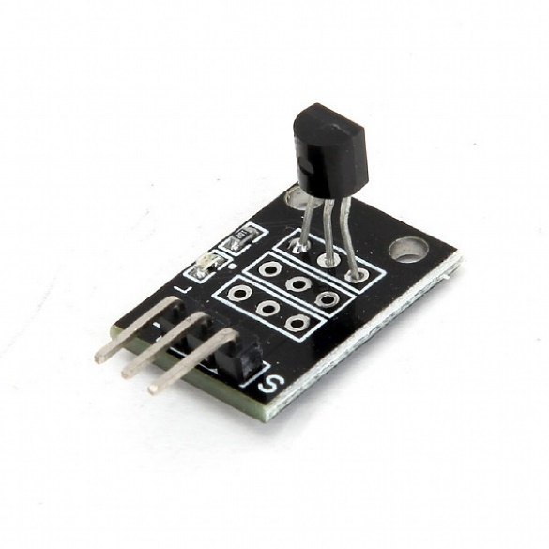
DS18B20 Sensor
The DS18B20 temperature sensor is a one-wire digital temperature sensor. This means that it just requires one data line (and GND) to communicate with an ESP32 or ESP8266.
It can be powered by an external power supply or it can derive power from the data line (called “parasite mode”), which eliminates the need for an external power supply.
Features –
Communicates over one-wire bus
Power supply range: 3.0V to 5.5V
Operating temperature range: -55ºC to +125ºC
Accuracy +/-0.5 ºC (between the range -10ºC to 85ºC)

Slide 5
One-Wire Protocol
The 1-Wire protocol is a single-wire interface for low-speed data communication in microcontrollers and computers. The protocol operates over a single data line without a clock signal. It’s a master-slave serial communication protocol where the half-duplex bidirectional data communication with multiple slaves is solely managed and controlled by a single master.

Slide 6
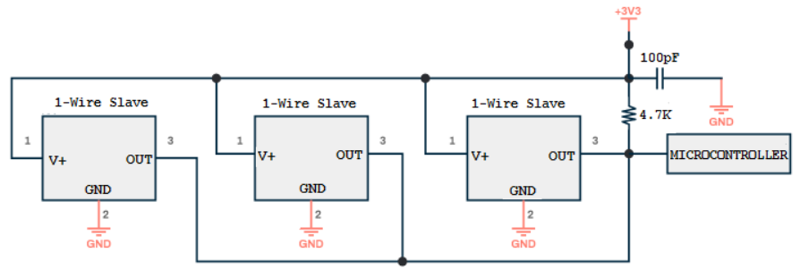
One-Wire (Conventional Powering)
The 1-wire standard bus has at least two wires. One is the data line and the other is the ground return. Both master and slaves have an open-drain (open-collector) connection with the data line. This is why a 4.7K resistor typically pulls the data line up. There are two possible powering modes for the 1-wire slave devices: parasitic and conventional. Conventional Power mode has been used for this project.
In a conventional powering mode, 1-wire slave devices are externally powered. An additional wire is traced to each 1-wire slave. The external power supply to the slaves ensures safe operation even in harsh, high-temperature conditions.
- This circuit shows one-wire conventional powering

Slide 7
Cloud Service - Firebase
Firebase provides a quick way to keep sensory data collected at the device level, and it works great with the Android APIs, which is supported by Android Things. A lot of mobile and device programmers that I have come across struggle with server-side programming.
Firebase can really help bridge that gap and make it easier. It will be interesting to see developers use its offline features. When any IoT device that collects data and needs to transmit it over networks, the golden rule to be assumed is that network connectivity cannot be assumed. As a result, you will need to collect the data offline and when the network is available, transmit this over to your server. Firebase with its offline features can really make this simple for a lot of developers.

Slide 8
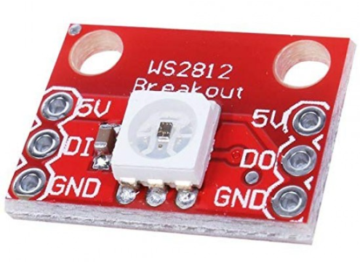
WS2812B RGB LED
WS2812B is an intelligent control LED light source that the control circuit and RGB chip are integrated in a package of 5050 components. Here, only one single component (LED) is used.
It internally includes intelligent digital port data latch and signal reshaping amplification drive circuit. Also it includes a precision internal oscillator and a 12V voltage programmable constant current control part, effectively ensuring the pixel point light color height consistency.
It is an LED with low driving voltage, environmental protection and energy saving, high brightness, scattering angle is large, good consistency, low power, long life. The control chip integrated in LED makes it a simple circuit with small volume and convenient installation.

Slide 9



Timeline
January
Testing DS18B20 sensor with ESP32 microcontroller.
February
Creating RTDB on Firebase.
March
Calibrating the sensor.
Using OneWire and DallasTemperature libraries for testing.
Integrating the RTDB with ESP32.
Adding Stream service on the RTDB in use.
Adding Timestamp to the temperature value, and sending the values as json to Firebase
April
Integrating everything together to make a cloud based prototype of both sensors.
Testing it with test cases of DS18B20.
Writing driver code for WS2812B.
Testing the driver codes.
Writing the OneWire and DallasTemperature Driver codes.
Adding Bluetooth Connectivity to the prototype to send data to the host
Adding an interface to set temperature and time.
Adding RTC module
Adding 7 segment Display to show real-time.

